Slide 1
8051 Microcontroller

Slide 2
Introduction
In addition to the features found in Microprocessor CPU, it also has ROM, RAM , parallel I/O, serial I/O, counters and a clock circuit.
True computer on a chip.
Its prime use is to control the operation of a machine using a fixed program that is stored in ROM and that does not change over the lifetime of the system.
Applications: Printer, Toaster, Automobile Engine Control, Motor Speed Control

Slide 3
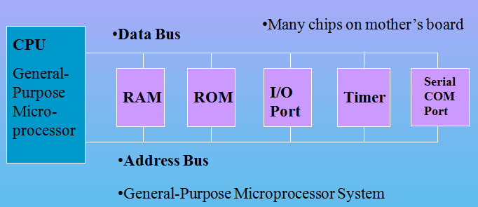
Microprocessor Based System
CPU
External RAM, ROM, I/O
(No internal RAM, ROM, I/O ports in the CPU)

Slide 4
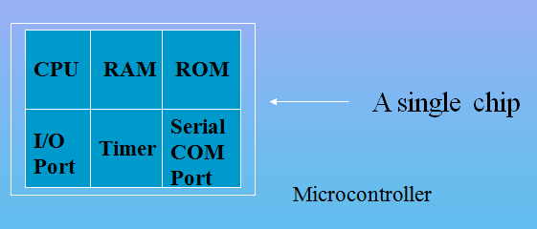
Microcontroller
A smaller computer on a CHIP
On-chip RAM, ROM, I/O Ports, Timer, Serial Controller…
Example: Motorola’s 6811, Intel’s 8051, Atmel 32

Slide 5
Comparison
MICROPROCESSOR | MICROCONTROLLER
No internal memory. | Contains RAM/ROM.
No interfacing circuits or counters or timers. | Contains serial I/O, parallel I/O, and counters.
Has many opcodes for moving data from external memory to CPU. | Has one or two opcodes.
Has one or two types of bit handling instructions. | They have many.
Concerned with rapid movement of code and data from external memory to CPU. | Concerned with rapid movement of bits within chip.
Must have many additional parts to be operational.(FD, K/B, CRT, etc) | Can function as a computer with no addition of external digital parts.
It is meant to fetch data, perform extensive calculations on that, and then store those calculations on mass storage devices or display the results for human use. | It is meant to fetch data, perform limited calculations on that data, and control its environment based on that calculation.
VON NEUMAN ARCHITECTURE | HARVARD ARCHITECTURE

Slide 6
μC based Embedded Systems
Special purpose computer system usually completely inside the device it controls
Has specific requirements and performs pre-defined tasks
Cost reduction compared to general purpose processor
Different design criteria
Performance
Reliability
Availability
Safety

Slide 7
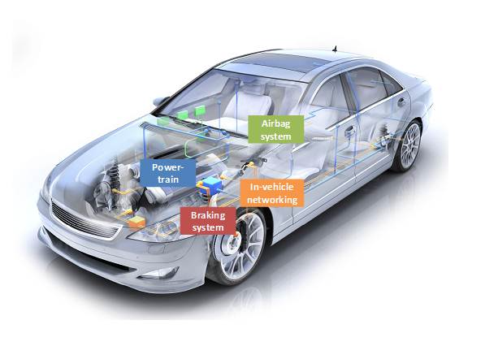
Embedded Systems Examples

Slide 8

Examples

Slide 9
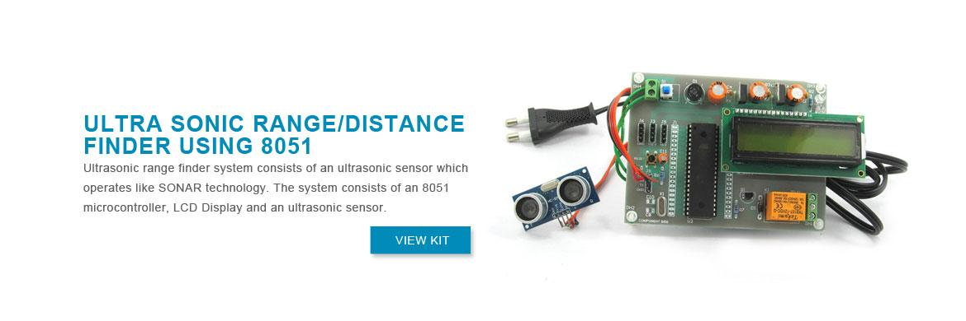

Slide 10
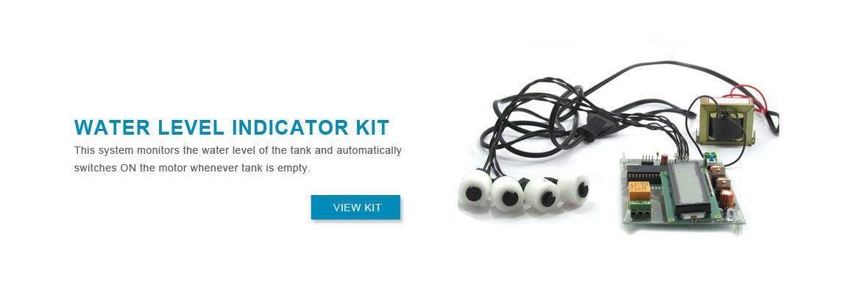

Slide 11
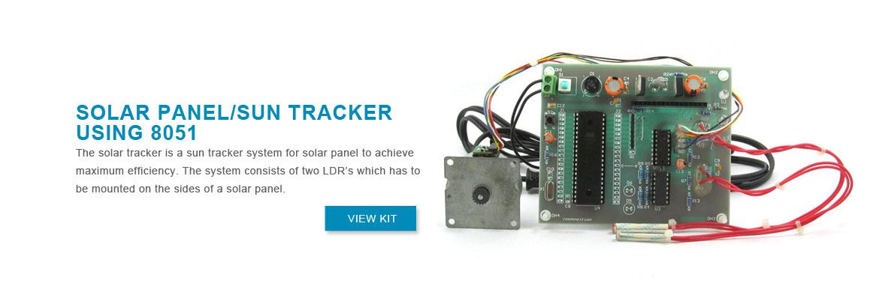

Slide 12
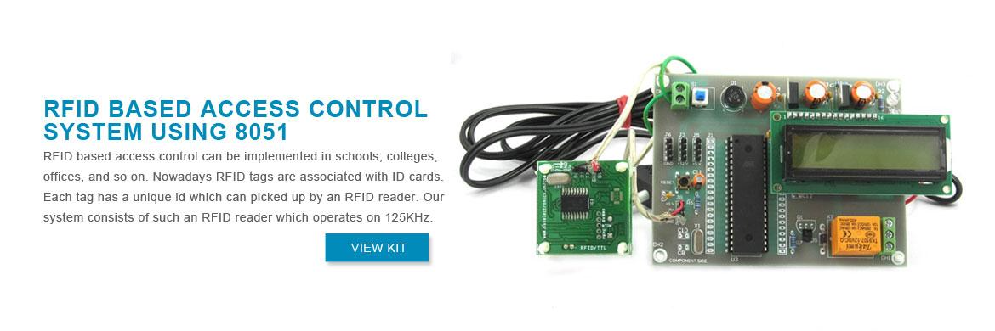

Slide 13
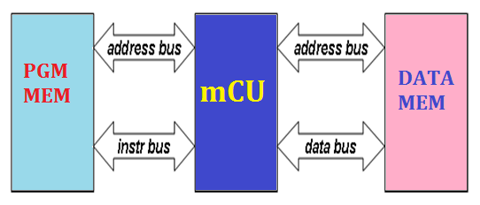
Harvard Architecture
In Harvard Architecture the data and instructions are stored in separate memory units each with their own bus.
Advantages:
Speeding up the data transfer rate,
Permits the designer to implement different bus widths and word sizes for program and data memory space.

Slide 14
8051 CPU Operation
Features
Pin Diagram
Block Diagram

Slide 15
8051 Microcontroller
Intel introduced 8051, referred as MCS- 51, in 1981.
The 8051 is an 8-bit processor
The CPU can work on only 8 bits of data at a time
The 8051 became widely popular after allowing other manufactures to make and market any flavor of the 8051.

Slide 16
Features of 8051
8 bit Processor
4KB Internal ROM
128 Bytes Internal RAM
Four 8 BIT I/O PORTS (32 I/O LINES)
Two 16 Bit Timers/Counters
On Chip Full Duplex UART for Serial Communication
5 Vector Interrupts ( 2 External, 3 Internal - Timer0,Timer1,Serial)
On Chip Clock Oscillator
16 bit Address bus
64k External Code Memory
64k External Data Memory
16-bit program counter to access external Code Memory and
16 bit Data Pointer to access external Data Memory
128 user defined flags
32 General Purpose Registers each of 8 bits

Slide 17
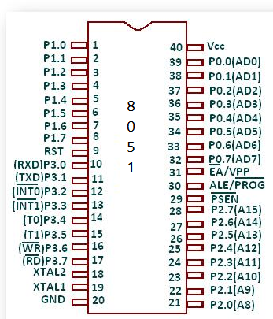
Pin Diagram

Slide 18
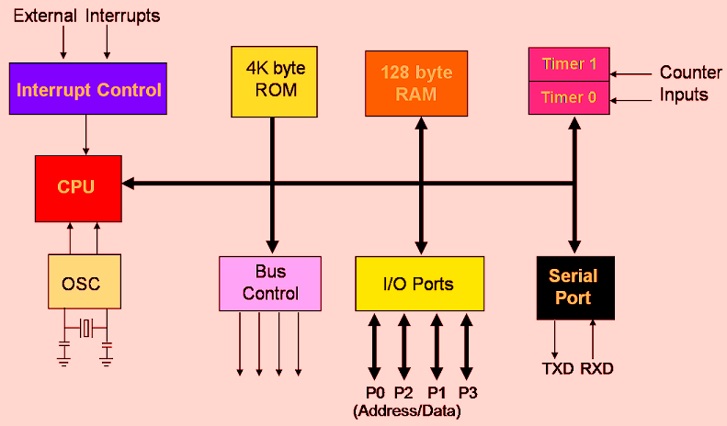
Block Diagram of 8051

Slide 20
Pin Description of the 8051
8051 family members (e.g., 8751, 89C51, 89C52, DS89C4x0)
Have 40 pins dedicated for various functions such as I/O, RD, WR, address, data, and interrupts.
Come in different packages, such as
DIP(dual in-line package),
QFP(quad flat package), and
LLC(leadless chip carrier)
Some companies provide a 20-pin version of the 8051 with a reduced number of I/O ports for less demanding applications

Slide 21
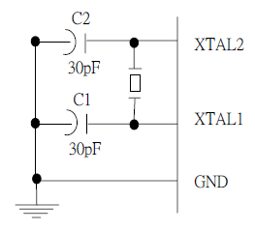
XTAL1 and XTAL2
The 8051 has an on-chip oscillator but requires an external crystal to run it
A quartz crystal oscillator is connected to inputs XTAL1 (pin19) and XTAL2 (pin18)
The quartz crystal oscillator also needs two capacitors of 30 pF value
The original 8051 operates at 12 MHZ

Slide 22
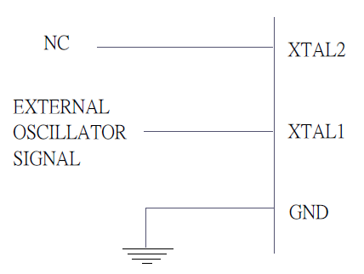
XTAL1 and XTAL2 …..
If you use a frequency source other than a crystal oscillator, such as a TTL oscillator:
It will be connected to XTAL1
XTAL2 is left unconnected

Slide 23
Machine Cycle
Find the machine cycle for
(a) XTAL = 11.0592 MHz
(b) XTAL = 16 MHz.

Slide 24
Machine Cycle
Find the machine cycle for
(a) XTAL = 11.0592 MHz
(b) XTAL = 16 MHz.
Solution:
(a) 11.0592 MHz / 12 = 921.6 kHz;
machine cycle = 1 / 921.6 kHz = 1.085 μs
(b) 16 MHz / 12 = 1.333 MHz;
machine cycle = 1 / 1.333 MHz = 0.75 μs

Slide 25
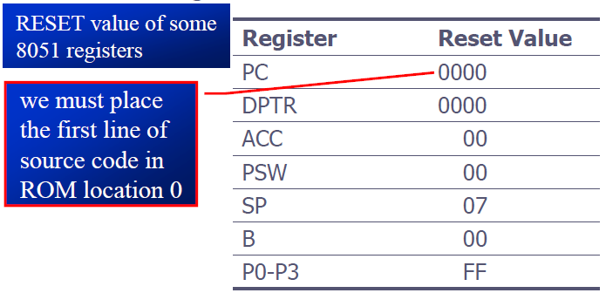
RST
RESET pin is an input and is active high (normally low)
Upon applying a high pulse to this pin, the microcontroller will reset and terminate all activities
This is often referred to as a power-on reset
Activating a power-on reset will cause all values in the registers to be lost

Slide 26
EA’
EA’, “external access’’, is an input pin and must be connected to Vcc or GND
The 8051 family members all come with on-chip ROM to store programs and also have an external code and data memory.
Normally EA pin is connected to Vcc (Internal Access)
EA pin must be connected to GND to indicate that the code or data is stored externally.

Slide 27
PSEN’ and ALE
PSEN, “program store enable’’, is an output pin
This pin is connected to the OE pin of the external memory.
For External Code Memory, PSEN’ = 0
For External Data Memory, PSEN’ = 1
ALE pin is used for demultiplexing the address and data.

Slide 28
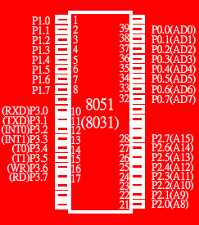
I/O Port Pins
The four 8-bit I/O ports P0, P1, P2 and P3 each uses 8 pins.
All the ports upon RESET are configured as output, ready to be used as input ports by the external device.

Slide 29
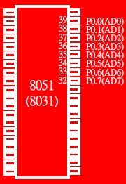
Port 0
Port 0 is also designated as AD0-AD7.
When connecting an 8051 to an external memory, port 0 provides both address and data.
The 8051 multiplexes address and data through port 0 to save pins.
ALE indicates if P0 has address or data.
When ALE=0, it provides data D0-D7
When ALE=1, it has address A0-A7

Slide 30
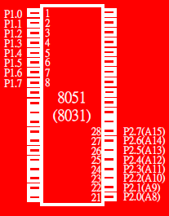
Port 1 and Port 2
In 8051-based systems with no external memory connection:
Both P1 and P2 are used as simple I/O.
In 8051-based systems with external memory connections:
Port 2 must be used along with P0 to provide the 16-bit address for the external memory.
P0 provides the lower 8 bits via A0 – A7.
P2 is used for the upper 8 bits of the 16-bit address, designated as A8 – A15, and it cannot be used for I/O.

Slide 31
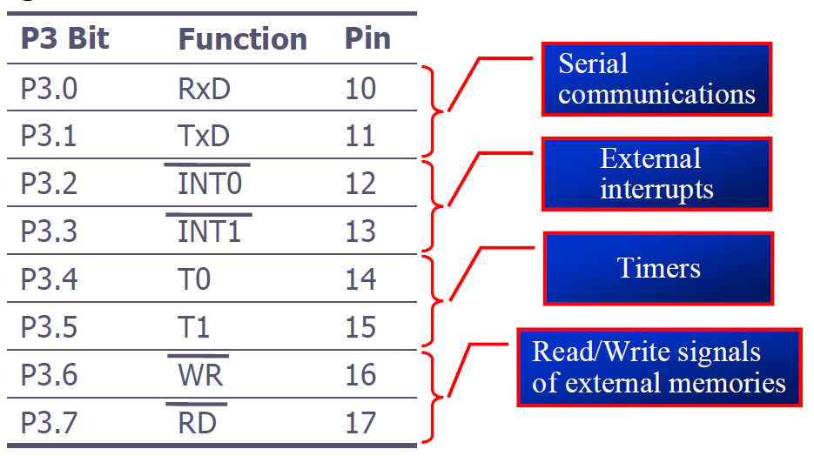
Port 3

Slide 32
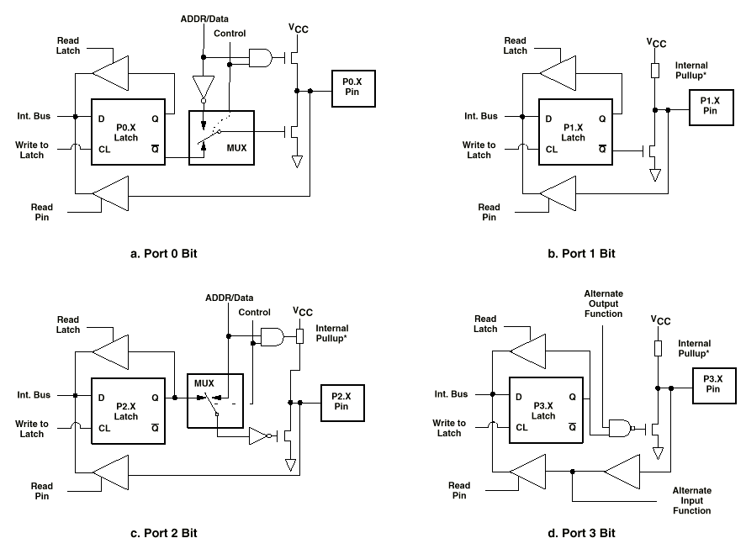

Slide 33
Pin Description Summary
PIN | TYPE | NAME AND FUNCTION
Vss | I | Ground: 0 V reference.
Vcc | I | Power Supply: This is the power supply voltage for normal, idle, and power-down operation.
P0.0 - P0.7 | I/O | Port 0: Port 0 is an open-drain, bi-directional I/O port. Port 0 is also the multiplexed low-order address and data bus during accesses to external program and data memory.
P1.0 - P1.7 | I/O | Port 1: Port I is an 8-bit bi-directional I/O port.
P2.0 - P2.7 | I/O | Port 2: Port 2 is an 8-bit bidirectional I/O. Port 2 emits the high order address byte during fetches from external program memory and during accesses to external data memory that use 16 bit addresses.
P3.0 - P3.7 | I/O | Port 3: Port 3 is an 8 bit bidirectional I/O port. Port 3 also serves special features as explained.

Slide 34
Pin Description Summary
PIN | TYPE | NAME AND FUNCTION
RST | I | Reset: A high on this pin for two machine cycles while the oscillator is running, resets the device.
ALE | O | Address Latch Enable: Output pulse for latching the low byte of the address during an access to external memory.
PSEN* | O | Program Store Enable: The read strobe to external program memory. When executing code from the external program memory, PSEN* is activated twice each machine cycle, except that two PSEN* activations are skipped during each access to external data memory.
EA*/VPP | I | External Access Enable/Programming Supply Voltage: EA* must be externally held low to enable the device to fetch code from external program memory locations. If EA* Is held high, the device executes from internal program memory. This pin also receives the programming supply voltage Vpp during Flash programming. (applies for 89c5x MCU's)

Slide 35
General Block Diagram of 8051
4K
ROM
Interrupt
Control
128 B
RAM
Timer 0
Timer 1
CPU
OSC
Bus
Control
4 I/O Ports
Serial
Port
TXD
RXD
P0
P1
P2
P3

Slide 36
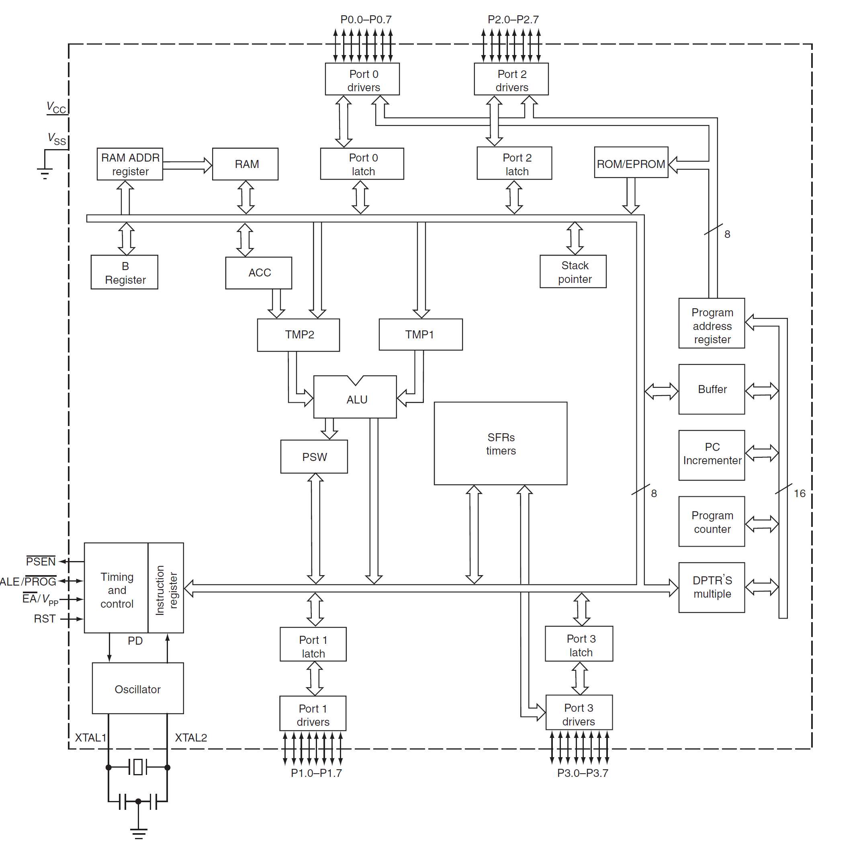

Slide 37
PC & Data Pointers
16 bit registers​
PC is Used to hold the address of a byte in memory​
Program instruction bytes are fetched from locations in memory that are addressed by PC.​
Program ROM may be on the chip at addresses 0000 H to 0FFF H, external to the chip for addresses that exceed 0FFF H or totally external for all addresses from 0000 H to FFFF H.​
The PC is automatically incremented after every instruction byte is fetched and may also be altered by certain instructions.​
PC is the only register that does not have an internal address.​
DPTR is made of 2 8-bit registers DPH and DPL.​
They are used to furnish memory addresses for internal and external code access and external data access.​
DPTR is under the control of program instructions.​
DPTR does not have single internal address (DPL & DPH are each assigned an address).​
​

Slide 38
A & b cpu registers​
34 GPR​
2 of these are A & B- mathematical core registers​
Other 32 arranged as part of internal RAM as four banks of registers, B0 to B3, of 8 registers each, named R0 to R7.​
A- addition, subtraction, integer multiplication, division, Boolean bit manipulations, data transfer between 8051 & external memory​
B- used with A register, or to store data​

Slide 39
FLAGS & program status word (psw)​
FLAGS are 1 bit registers provided to store the result of certain program instructions.​
Other instructions can test condition of flags and make decisions based upon the flag states.​
Flags are grouped inside PSW & PCON (power control) registers.​
8051 has 4(math flags) + 3(general purpose user) = 7 flags.​
Math flags respond automatically to the output of math operations ( carry C, auxiliary carry AC, overflow OV and parity P).​
G.P.F. can be set to 1 or cleared to 0by the programmer as desired (F0, GF0 & GF1).​
All flags can be set or cleared by programmer at will.(math flags?)​

Slide 40
Cont…
PSW contains​
Math flags​
User program flags F0​
Register select bits ( selects which of the 4 GPR banks are in use by program)​
*GF0 & GF1 are stored in PCON.​

Slide 41
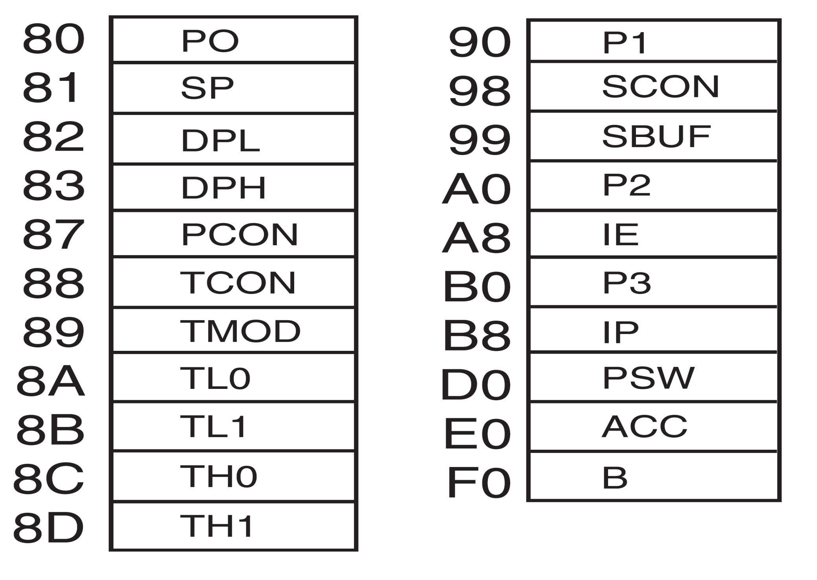
Special Function Registers [SFR]
SFR is used for operations where internal 128 B RAM addresses ( 00 H to 7F H) are not used.​
These are addressed from 80 H to FF H*.​
Some SFRs are bit addressable.​

Slide 42
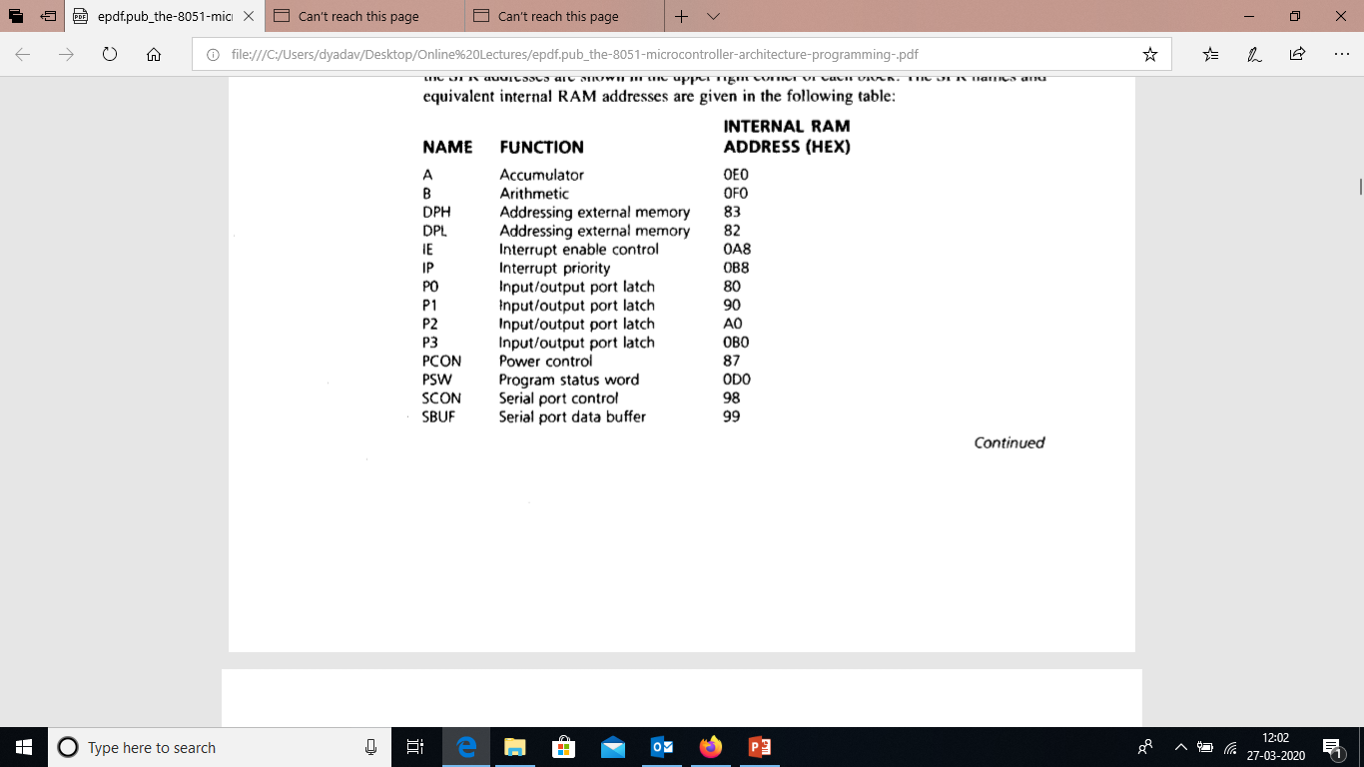
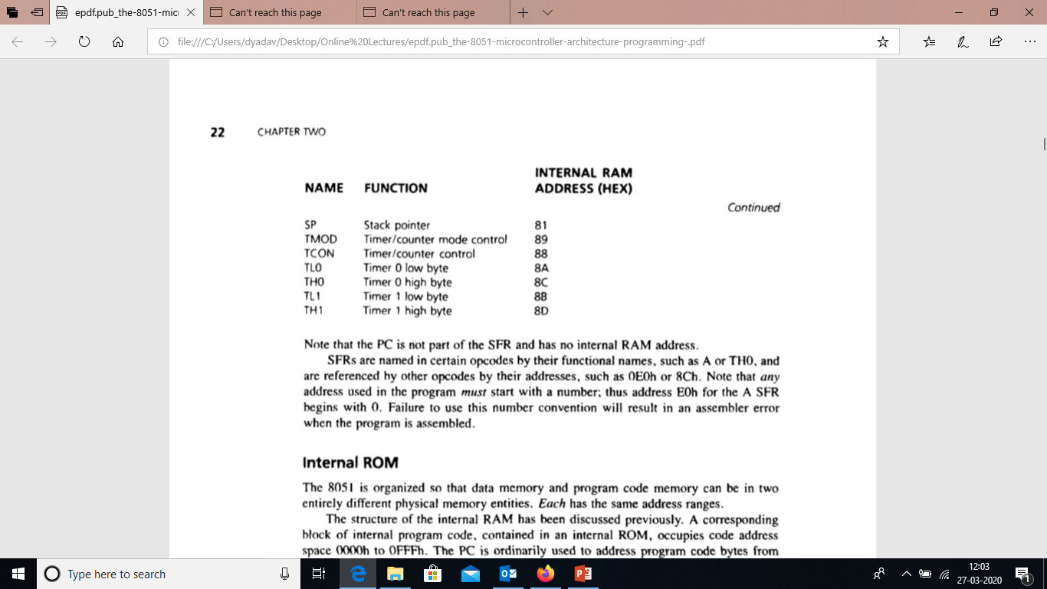

Slide 43
Program Status Word [PSW]
C AC F0 RS1 RS0 OV F1 P
Carry
Parity
Auxiliary Carry
User Flag 1
User Flag 0
Register Bank Select
Overflow

Slide 44
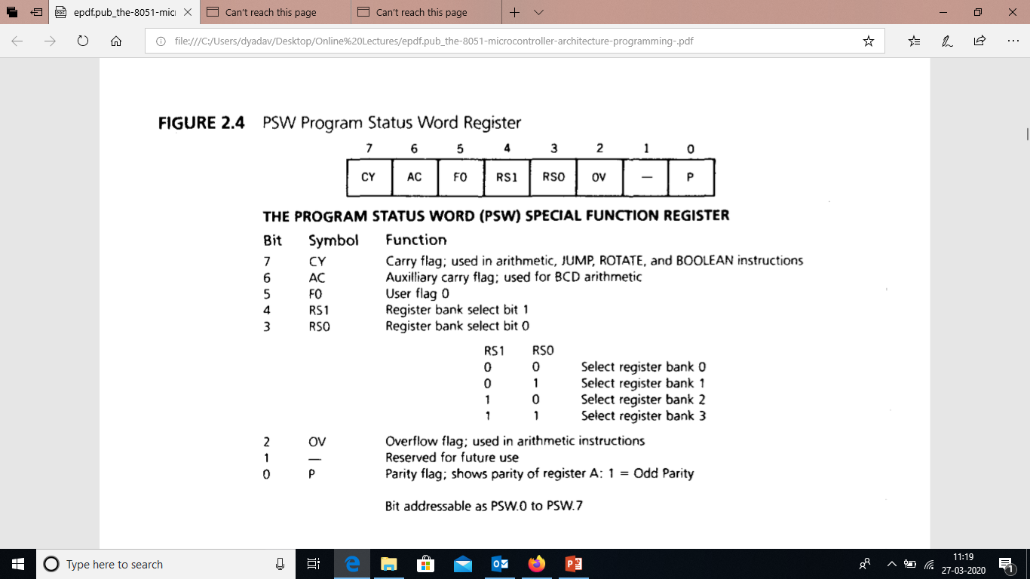

Slide 45
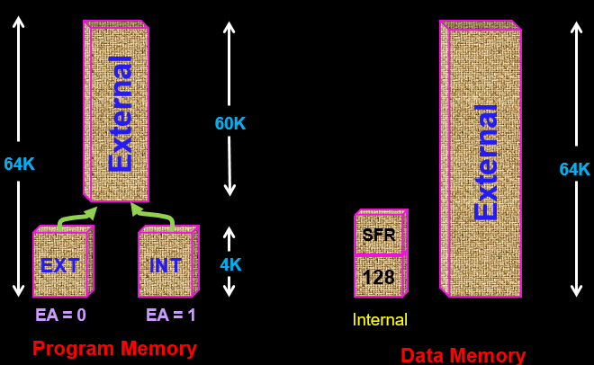
8051 Memory Space

Slide 46
Internal RAM Structure
Direct
Addressing
Only
SFR [ Special Function Registers]
Direct &
Indirect
Addressing
128 Byte Internal RAM

Slide 47
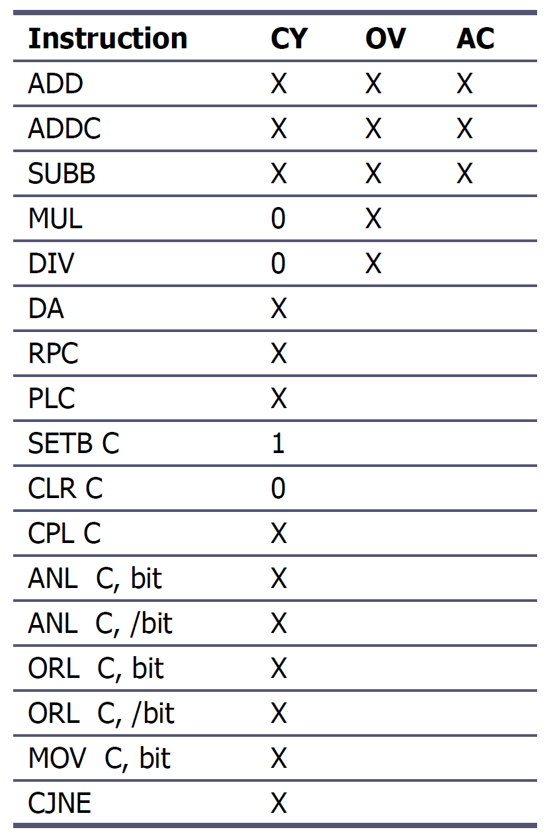
8051 instructions that affects flag

Slide 48
128 Byte RAM
General Purpose
Area
There are 128 bytes of RAM in the 8051.
Assigned addresses 00 to 7FH
The 128 bytes are divided into 3 different groups as follows:
A total of 32 bytes from locations 00 to 1F hex are set aside for register banks and the stack.
A total of 16 bytes from locations 20H to 2FH are set aside for bit-addressable read/write memory.
A total of 80 bytes from locations 30H to 7FH are used for read and write storage, called scratch pad.
BIT Addressable
Area
Reg Bank 3
Reg Bank 2
Reg Bank 1
Reg Bank 0

Slide 49
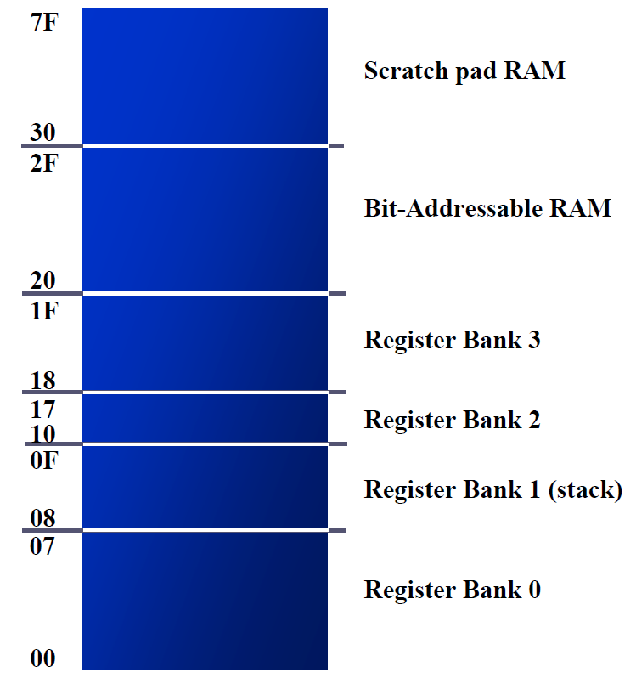
8051 RAM with addresses

Slide 50
8051 Register Bank Structure
Bank 3
R0 | R1 | R2 | R3 | R4 | R5 | R6 | R7
Bank 2
R0 | R1 | R2 | R3 | R4 | R5 | R6 | R7
Bank 1
R0 | R1 | R2 | R3 | R4 | R5 | R6 | R7
Bank 0
R0 | R1 | R2 | R3 | R4 | R5 | R6 | R7

Slide 51
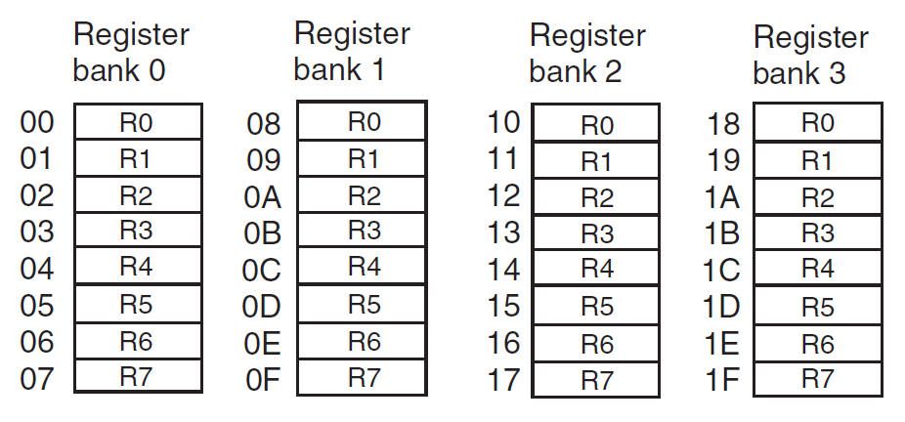
8051 Register Banks with address

Slide 52
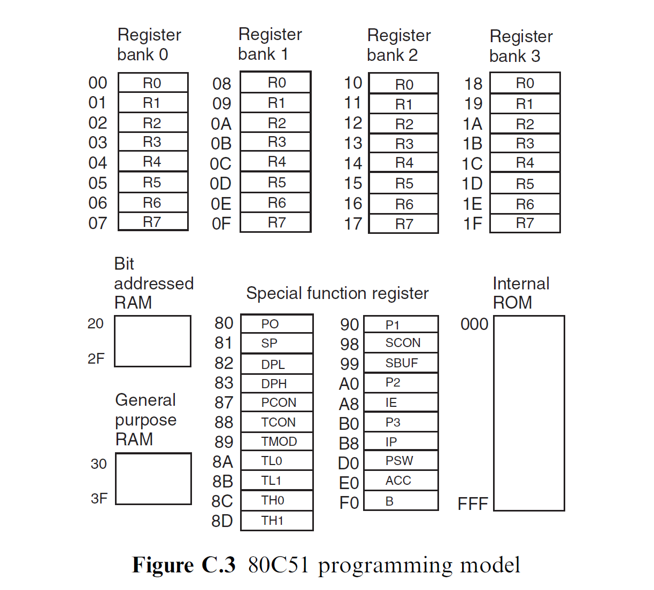
8051 Programming Model

Slide 53
8051 Stack
The stack is a section of RAM used by the CPU to store information temporarily.
This information could be data or an address
The register used to access the stack is called the SP (stack pointer) register
The stack pointer in the 8051 is only 8 bit wide, which means that it can take value of 00 to FFH
When the 8051 is powered up, the SP register contains value 07
RAM location 08 is the first location begin used for the stack by the 8051

Slide 54
Cont…
The storing of a CPU register in the stack is called a PUSH
SP is pointing to the last used location of the stack
As we push data onto the stack, the SP is incremented by one
This is different from many microprocessors
Loading the contents of the stack back into a CPU register is called a POP
With every pop, the top byte of the stack is copied to the register specified by the instruction and the stack pointer is decremented once

Slide 55
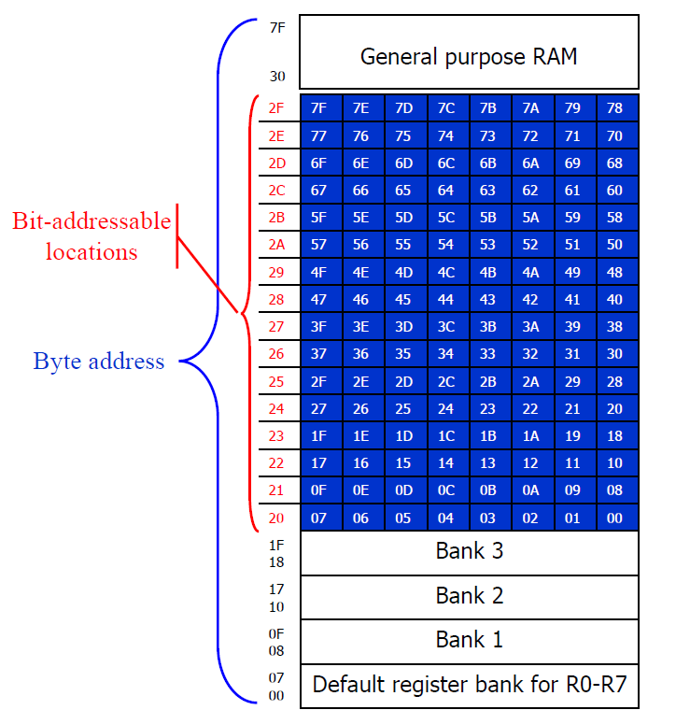
Bit Addressable & Byte Addressable

Slide 56
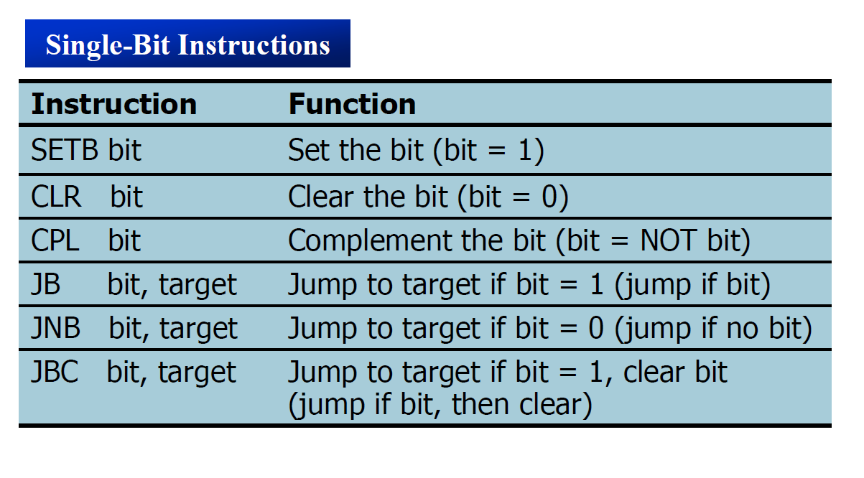
Single bit Instructions

Slide 57
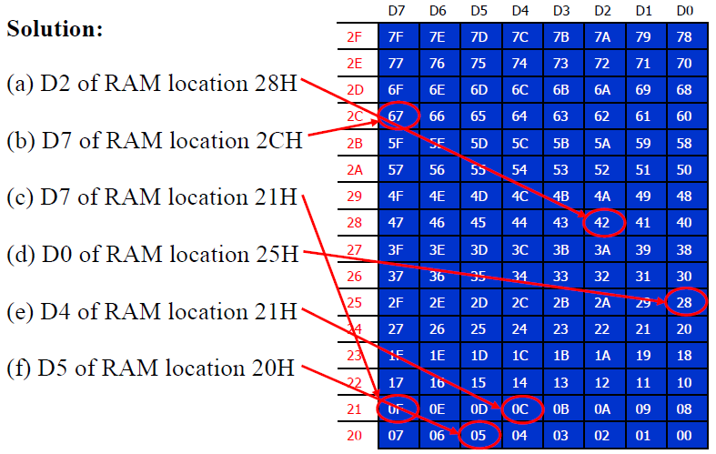
Bit Addressable Programming
Example: Find out to which by each of the following bits belongs. Give the address of the RAM byte in hex
(a) SETB 42H, (b) CLR 67H, (c) CLR 0FH (d) SETB 28H, (e) CLR 12, (f) SETB 05

